Slide 1
Diabetes Health Care Prediction Model
Presented by
USN: 1BI21CS143 NAME: Sirisha M
Internal guide: External Guide:
Dr. Gunavathi HS Dr. Nagarajan Srinivasan
Associate Dean, Skill Development Instructor
Assistant Professor, IOBrain Innovative Labz
Dept of CSE,BIT Bengaluru

Slide 2
Agenda
Introduction
Problem Statement
Proposed System
Algorithm
Tools and Technologies
Results
7. Applications
8. Reflection Notes
9. Conclusion
10. References
11. Certificate

Slide 3
Introduction
Diabetes is a chronic metabolic disorder characterized by elevated blood sugar levels.
According to the International Diabetes Federation, approximately 537 million people are living with diabetes worldwide, and the numbers continue to rise. Effective management and personalized care are essential to mitigate the impact of this condition.
The key to effective diabetes management lies in data. Accurate and comprehensive datasets provide the foundation for understanding patient profiles, treatment outcomes, and trends.
However, the sheer volume and complexity of healthcare data make it challenging for traditional methods to extract meaningful insights

Slide 4
Problem Statement
Develop a classification algorithm to accurately predict whether patients have diabetes or not.
Input: A dataset with medical predictor variables such as the number of pregnancies, glucose levels, blood pressure, skin thickness, insulin levels, BMI, diabetes pedigree function, and age.
Output:The binary outcome variable (Outcome) indicates whether a patient has diabetes (1) or not (0).

Slide 5
Proposed System
Data Collection: Gathering comprehensive health data including patient information such as diagnostics, treatments, lifestyle, and monitoring.
Data Preprocessing: Cleaning, transforming, and normalizing data to ensure consistency and reliability.
Feature Extraction: Identifying relevant features that contribute to effective classification.
Classification Model: Implementing machine learning classification algorithms to categorize patients into relevant groups.

Slide 6
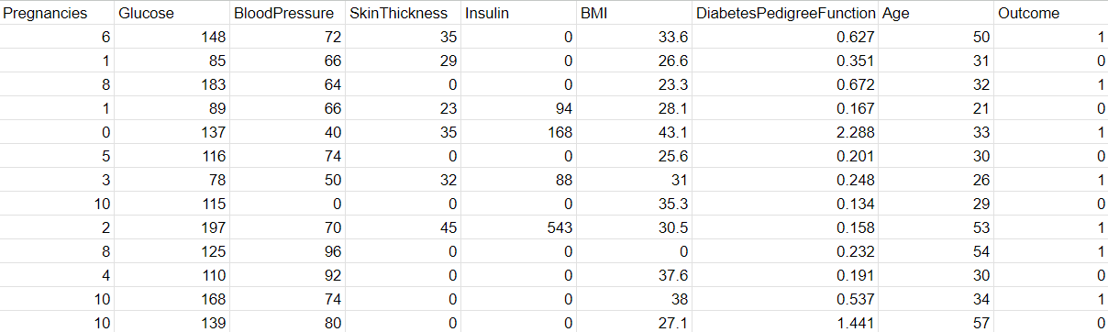
A sample of the dataset:

Slide 7
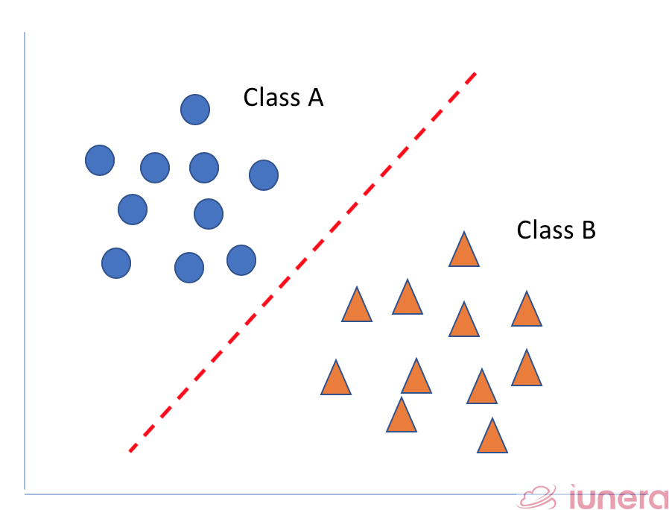
Algorithms
On the dataset, we apply three algorithms namely, Support Vector Machine, Decision Tree and Random Forest Classifier out of which I will be deploying Random Forest classifier on the test data because of its performance.
Support Vector Machine (SVM) : It is a supervised machine learning algorithm used for classification and regression tasks. Its primary objective is to find a hyperplane that best separates the data into different classes.
In the case of binary classification, this hyperplane aims to maximize the margin between the two classes, where the margin is defined as the distance between the hyperplane and the nearest data points (support vectors) from each class.

Slide 8
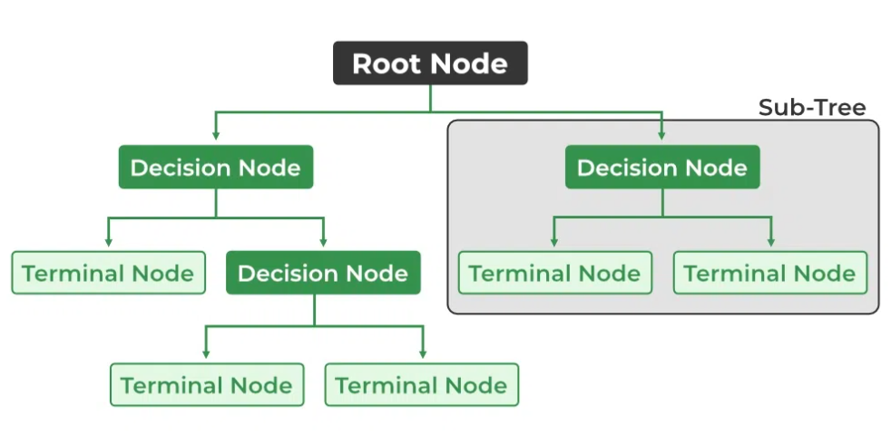
A Decision Tree: It is a popular supervised machine learning algorithm used for both classification and regression tasks. It works by recursively partitioning the dataset into subsets based on the values of different features.
The decision-making process can be visualized as a tree-like structure, where each internal node represents a decision based on a specific feature, each branch represents the outcome of the decision, and each leaf node represents the final decision or the target variable.

Slide 9
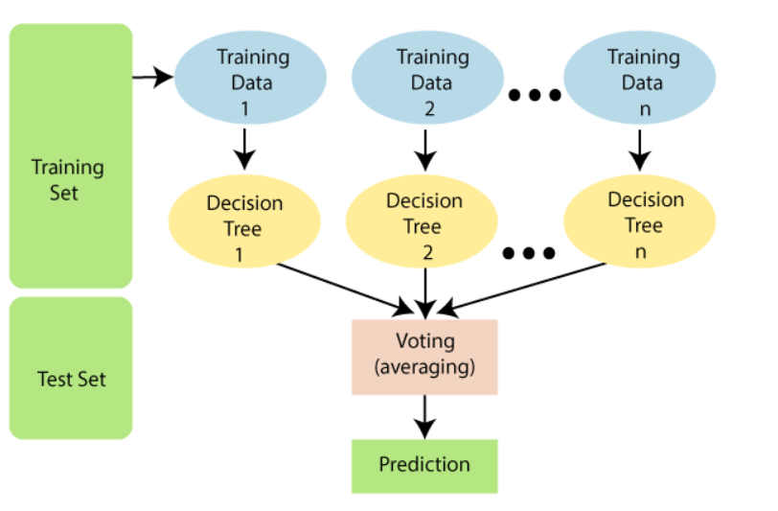
Random Forest Classifier: It is an ensemble learning method used for both classification and regression tasks. It builds multiple decision trees during training and merges them together to get a more accurate and stable prediction.
Random Forest begins by creating multiple subsets of the original dataset through a process called bootstrapping. Each subset is created by randomly sampling data points with replacement. This means that some instances may appear multiple times in a subset, while others may not appear at all. Once all the decision trees are built, they vote. For classification, the class with the majority of votes becomes the predicted class.

Slide 11
After the data preprocessing is done and split to training and test data, the model is built and it begins to learn.
In the context of this particular dataset,each decision tree in the Random Forest independently evaluates the health features and begins to build decision trees. The number of estimators (trees) is a crucial parameter.
The root node in a decision represents the entire dataset and all these parameters above form the decision nodes. The leaf nodes are formed during the training process and represent the outcome and in this case it is 1 (diabetic).
The splitting criteria are implicitly defined during the training of the Random Forest. Each decision node is associated with a specific feature and a decision rule, which becomes part of the splitting criteria.

Slide 12
Tools and Technologies
Programming language: Python
Machine Learning libraries used:
Numpy : A library for numerical operations in Python. Handling numerical arrays and performing operations on them.
Pandas : A data manipulation library for Python that provides data structures like data frames. Loading, cleaning, and preprocessing datasets.
Scikit learn : A collection of tools for data mining and data analysis. Implementing machine learning algorithms and utilities.
Seaborn and Matplotlib : Visualization libraries for Python. Plotting graphs and charts to visualize data and model performance.
IDE: Jupyter Notebook

Slide 13
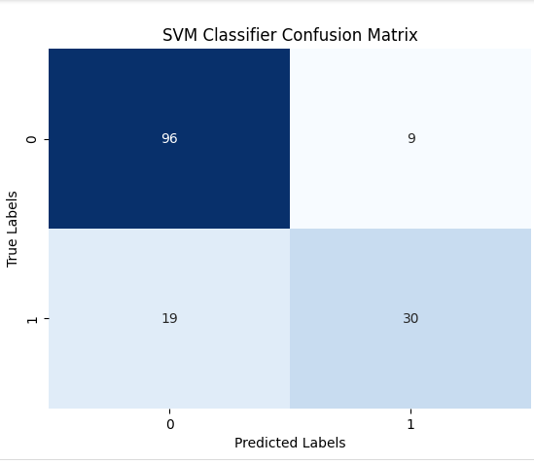
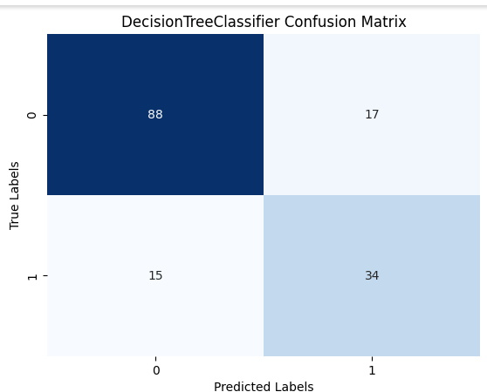
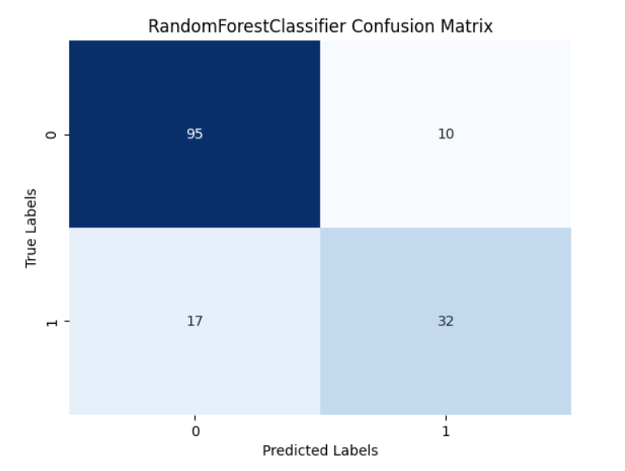
Results

Slide 14
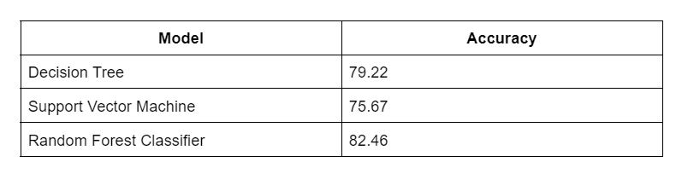
Comparison of the three models

Slide 15
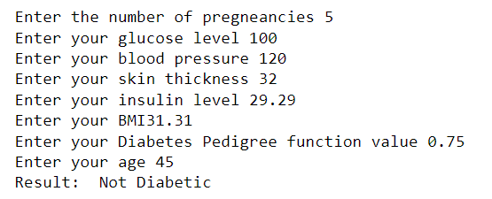
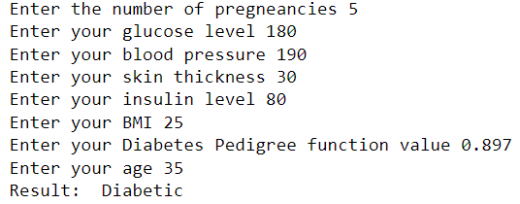
Prediction with a test data

Slide 16
Applications
1 Medical Diagnosis: Predicting whether a person has diabetes or not based on health-related features can be valuable for medical diagnosis.
2. Patient Risk Assessment: Healthcare providers can use the model to assess the risk of diabetes for patients, enabling proactive interventions and personalized care.
3. Preventive Healthcare: Identifying individuals at a higher risk of developing diabetes allows for early preventive measures, lifestyle interventions, and health management strategies.
4. Data Analysis and Exploration: The initial data analysis provides insights into the dataset, helping understand the characteristics of the health care data.

Slide 17
Reflection Notes
Technical Outcomes:
Project Contributions: I implemented key machine learning algorithms, notably Random Forest Classifier, resulting in significant improvements in my data analysis and predictions.
Skill Enhancement: I learnt about various concepts in machine learning, such as usage of various libraries, model tuning and thus applying them effectively to optimize model performance.
Problem Solving: I was able to successfully tackle challenges related to the data preprocessing and accuracy of my models, showcasing adept problem-solving and analytical skills in the realm of machine learning.
Utilization of Technologies: I was able make use of cutting-edge machine learning technologies and frameworks to enhance the accuracy and efficiency of the models.

Slide 18
Non-Technical Outcomes:
Verbal and Written Communication: I improved my communication skills through clear articulation of machine learning concepts, methodologies, and findings, facilitating effective communication with both technical and non-technical stakeholders.
Time Management: I honed time management skills in the context of model development, feature engineering, and iterative model training, ensuring the timely completion of project milestones.
Resource Utilization: I enhanced resource utilization skills by effectively managing data, computational resources, and model training pipelines, optimizing efficiency throughout the machine learning project lifecycle.
Problem Resolution and Decision-making: I gained experience in resolving machine learning-specific challenges and making informed decisions, contributing to the refinement and optimization of the models.

Slide 19
Conclusion
My internship introduced me to the realm of machine learning, where I discovered a constantly evolving landscape of tools and technologies. I learned that strategic selection and integration of these tools play a crucial role in creating and implementing predictive models effectively.
Through the intricate journey of model development, feature engineering, and hyperparameter tuning, I've not only significantly enhanced my technical prowess but also delved into the nuanced world of critical decision-making in data science.
The implementation of advanced algorithms and ensemble learning techniques has not only optimized predictive accuracy but has also underscored the power of data-driven insights.
I appreciate the challenges and lessons that have shaped my development, and I eagerly anticipate applying these newly acquired skills and perspectives in my future endeavors.

Slide 20
References
[1] DataCamp. "Random Forests Classifier in Python." [Online]. Available: https://www.datacamp.com/tutorial/random-forests-classifier-python#:~:text=Random%20forests%20are%20for%20supervised,combine%20predictions%20from%20other%20models
[2] GeeksForGeeks. "Introduction to Decision Tree with Example." [Online]. Available: https://www.geeksforgeeks.org/decision-tree-introduction-example/
[3] GeeksForGeeks. "Support Vector Machine (SVM) Algorithm." [Online]. Available: https://www.geeksforgeeks.org/support-vector-machine-algorithm/
[4] W3Schools. "Getting Started with Machine Learning in Python." [Online]. Available: https://www.w3schools.com/python/python_ml_getting_started.asp

Slide 21


